Slide 1
"We hadn’t thought about that before!"

Slide 4
Innovation

Slide 5
Explore The Challenge
Generate Ideas
Prepare For Action

Slide 6
“Concept Corner”

Slide 7
Explore The Challenge
Retain numbers
Increase numbers
Adding Value
What is wanted
To be innovative
New speakers

Slide 8
Generate New Ideas
Mind maps
Be crazy
Open minded
Group work

Slide 9
Prepare For Action
Meet Criteria
Team members
Test it
Resources

Slide 10
Your Challenge
Grow
Retain
Entertain
You have 10 mins

Slide 11
"We hadn’t thought about that before!"

Slide 12
Leadership
Creates respect
Helps achieve goals

Slide 13
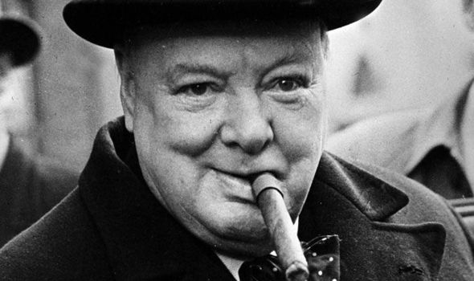
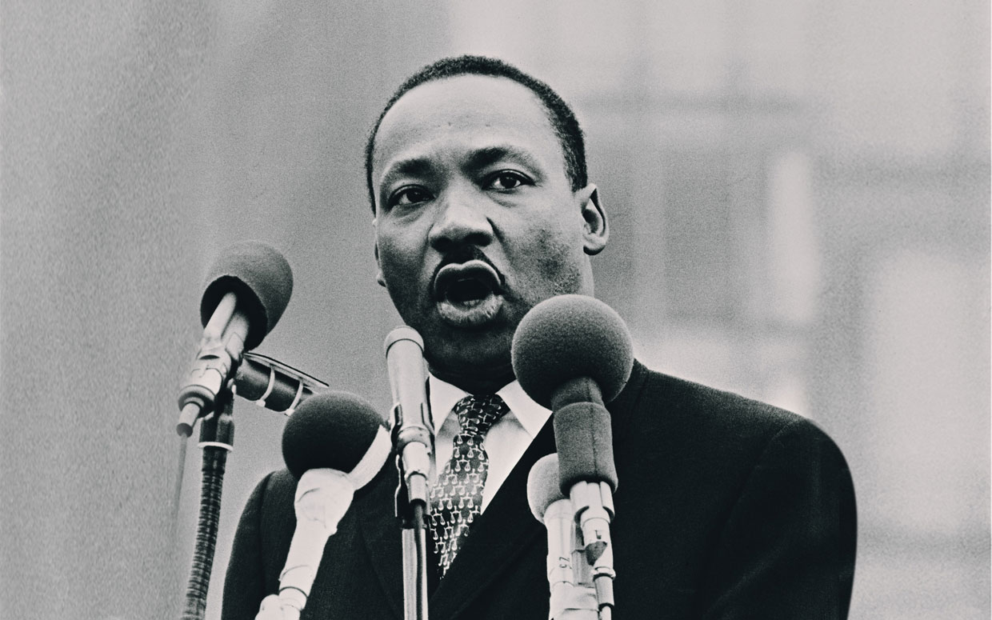
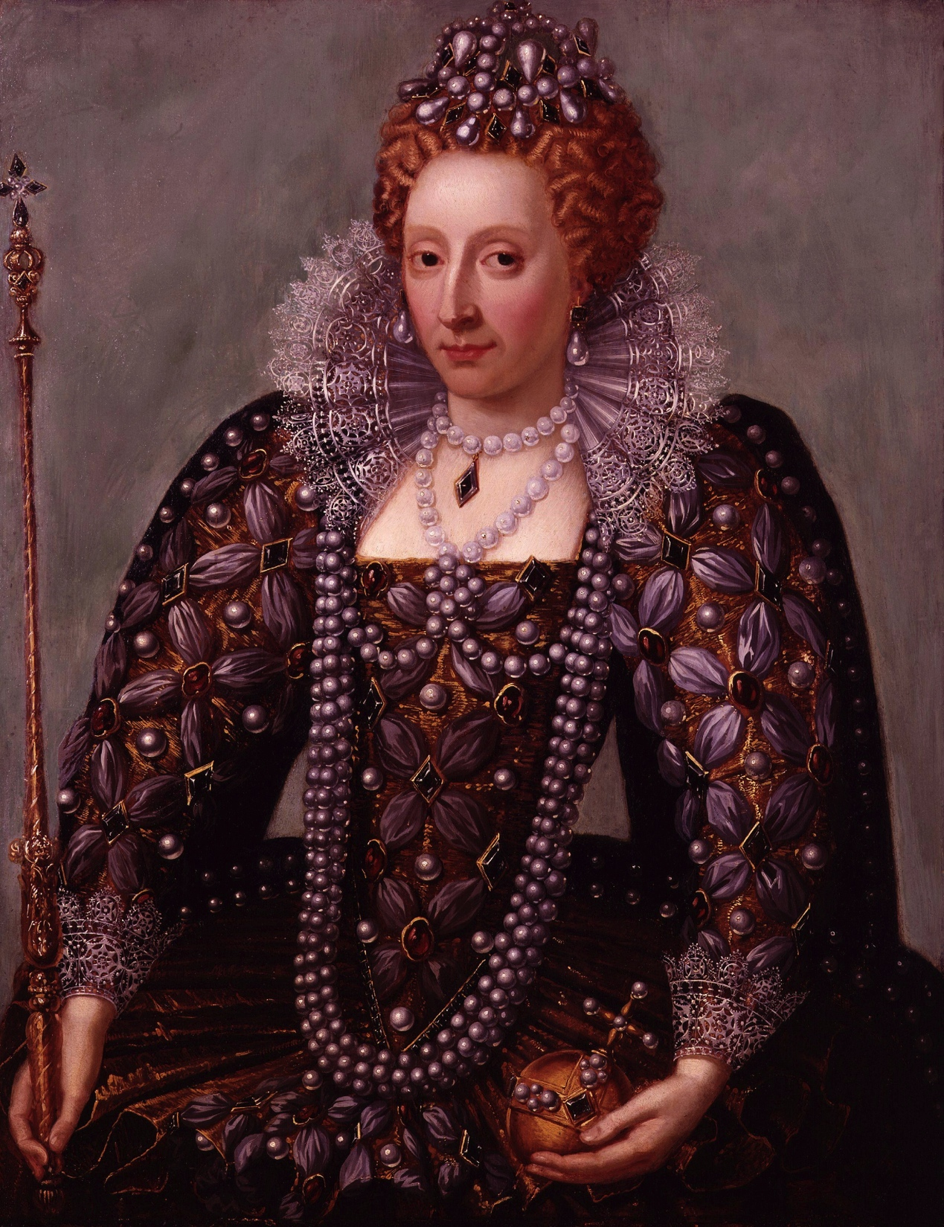
Traits of Leaders

Slide 14
Core Beliefs
What are you about?
What do you care for?
What are your intentions?

Slide 15
Change

Slide 16
Emotional Bank Account
Credits
Withdrawals
Overdrawn
Start in Credit
Stay in Credit

Slide 17
Balance Scorecard
100 Points
Weighting importance
Add up total scores

Slide 18
Looking Like This..?
Previous meeting “10”
Latest News “20”
Speaker “40”
QnA “20”
Close “10”

Slide 19
Type of Speaker
Motivational“20”
Advertising“20”
Converting Pupils “10”
ADI Training “15”
Fleet “5”
Software “5”
Standards Check “25”

Slide 20
Grow, Retain, Entertain
Listen
Create
Communicate

Slide 21
Month 1: Marketing

Slide 22
Month 2: Sales

Slide 23
Month 3: Skills of an ADI

Slide 24
Month 4: Customer Service

Slide 25
Let’s Do Food

Slide 26
Buy Your Next Association Website
www.associationwebsites.co.uk

