Slide 1
Back in 2010…
In A DSA Office Far Far Away…
DSA were worried about the Practical (Car) Driving Test

Slide 2
So What Happened?
People got together
DSA, ADI’s & Pupils and did stuff
Boffins & scientists observed enthusiastically
Conclusions were made, reports were written
The practical car test fundamentally changed
The rest is history
Or is it? Let’s look deeper…

Slide 3
Problems?
Does passing the“L-Test” properly prepare new drivers to drive & survive today’s roads?
Why are accident & insurance statistics much higher for new drivers, particularly 17-25 YO?
Is driver education correct / adequate?
Is the driver testing correct / adequate?
What do new drivers say about their early (post-test) driving experiences?

Slide 4

Possible Solutions
Re-evaluate Existing Driver Training
Re-assess Current Driving Test(s) Content
Research Best Practice (other countries)
Commission UK Research
Analyse Driver Behaviour
Control Groups - stats
Implement trials

Slide 5
Is Driving A Bit Like This?
Behaviour
  “The Basics” - how
  “The Rules” – what
  “The Plan” – which
  “The Person” – why
Training
  Knowledge / Ability
  Attitude to Risk
  Independence / reflection

Slide 6
Why is everyone talking about:
Coaching?
GDE Matrix?
Independent Driving?
Answer:
  Because these, and other “new ideas”, are CPD (or training) opportunities, for trainer trainers!
  People can make money from you by teaching you about “stuff” that maybe you already know!

Slide 7
So I Googled
“GDE Matrix”…

Slide 8
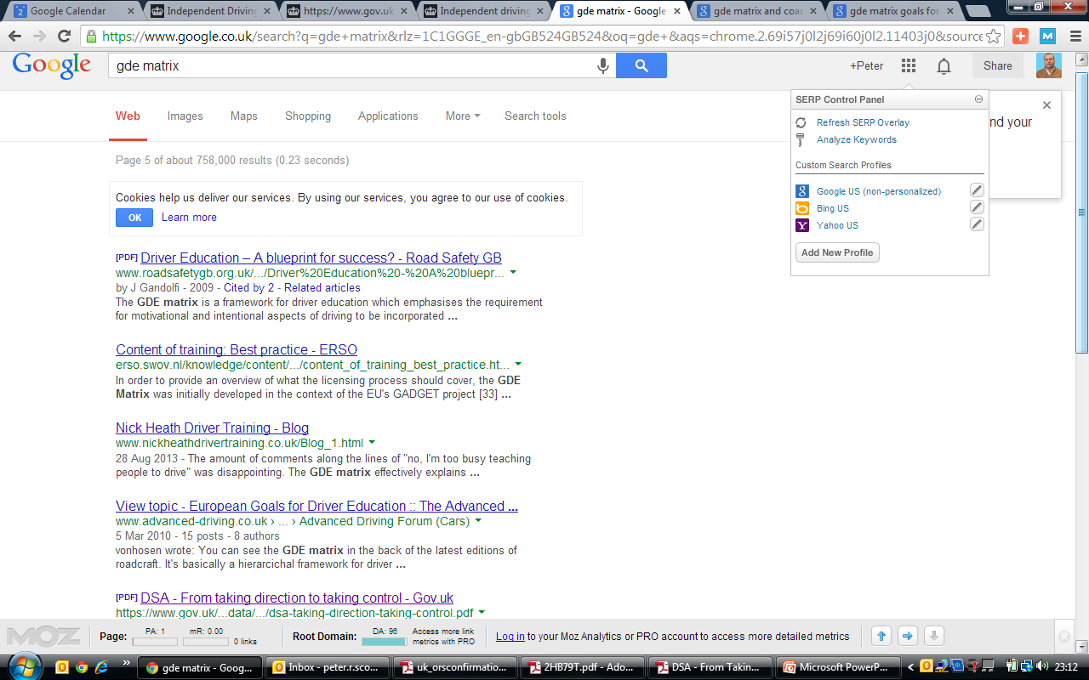
I Found this on Page 5 of my search, and, as it was by DSA, I took a look!

Slide 9
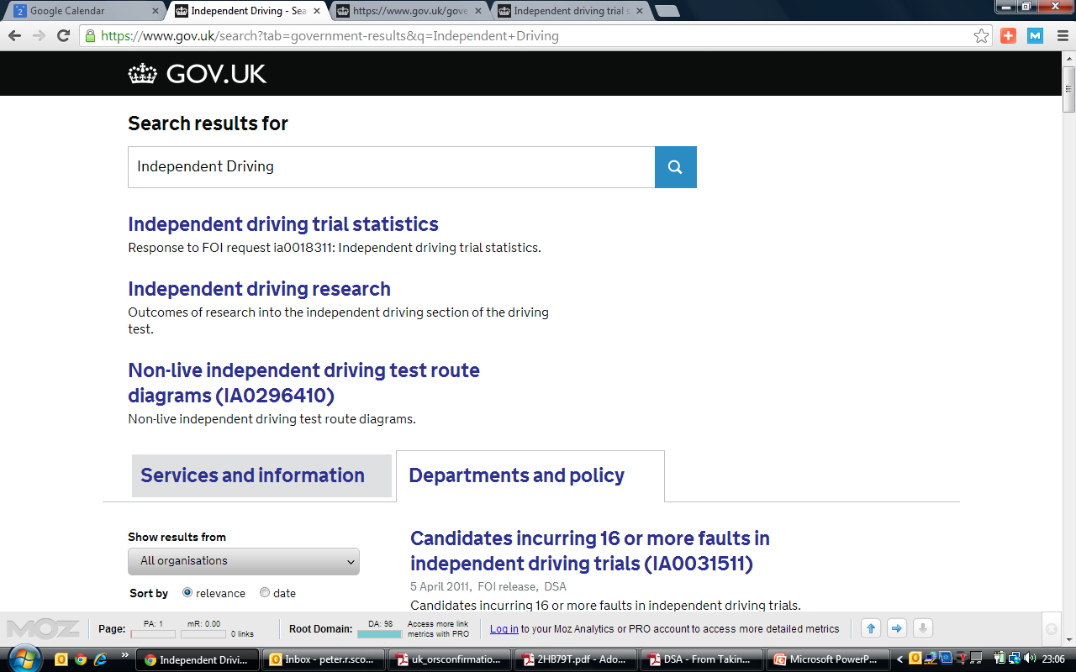

Slide 10
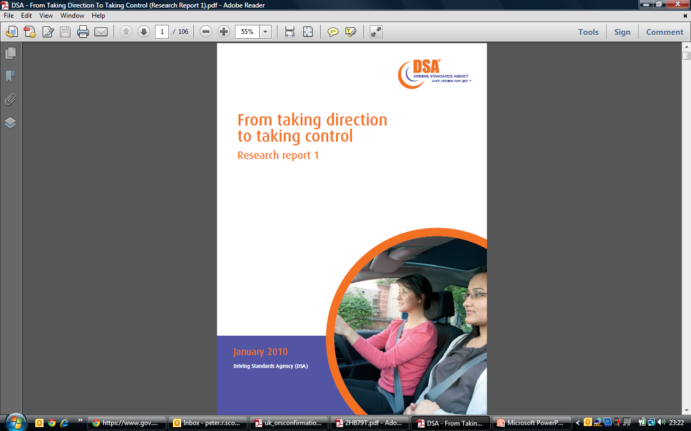
Its’ 106 pages long

Slide 11
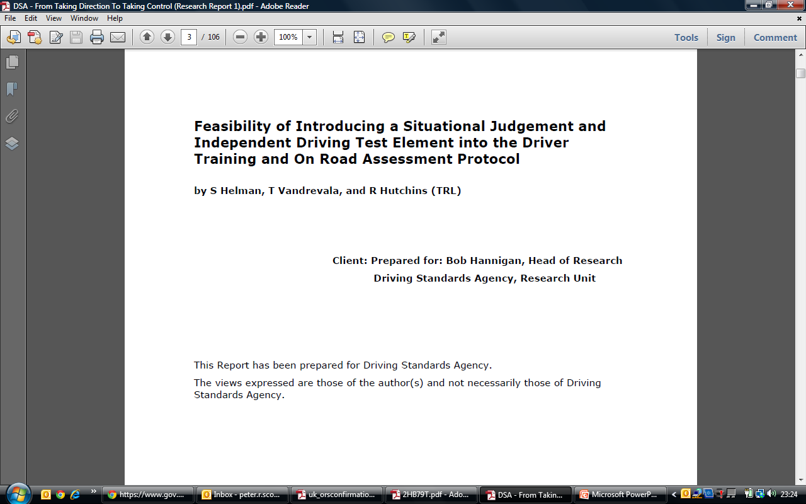

Slide 12
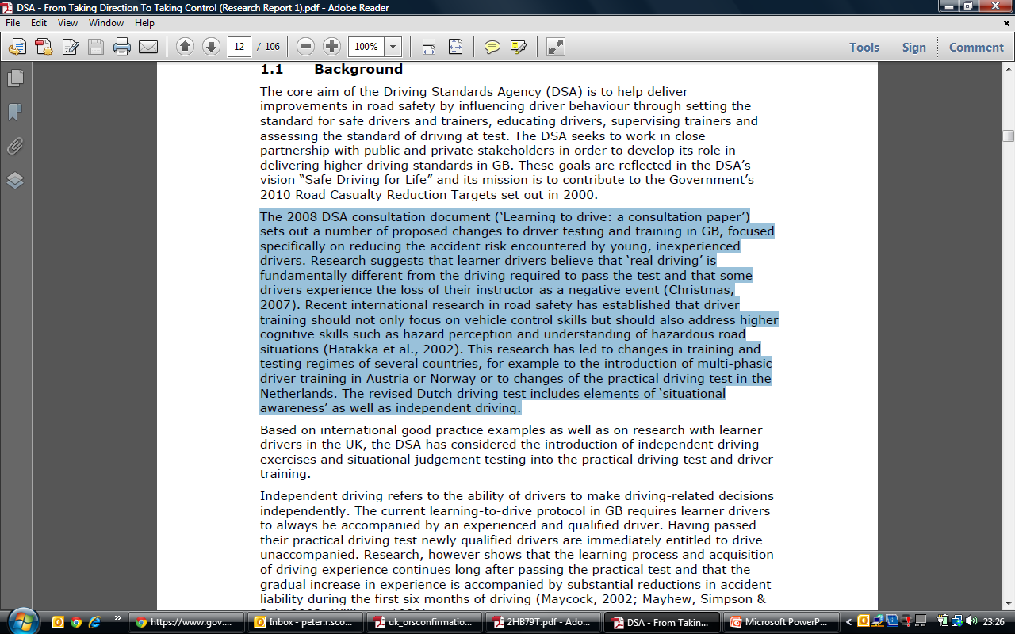

Slide 13
Independent Driving
Navigational (ability)
Recovery (ability)
Following maps / sketches
Following instructions
Following road signs
Knowing you’ve gone wrong
Planning a ‘get out solution’
Turning around / back-track

Slide 14
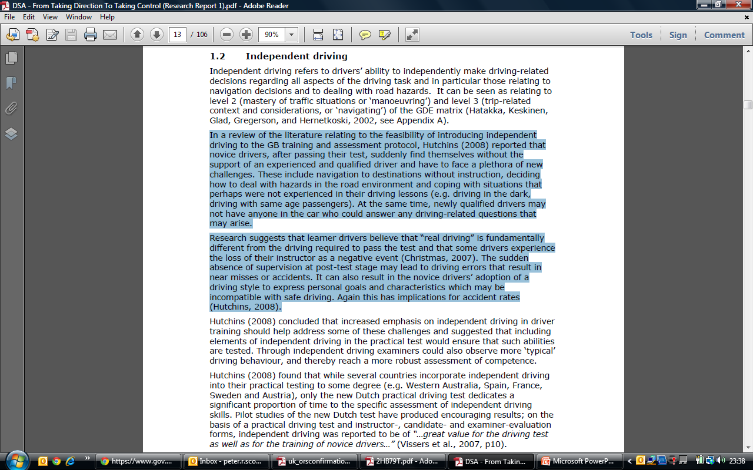

Slide 15
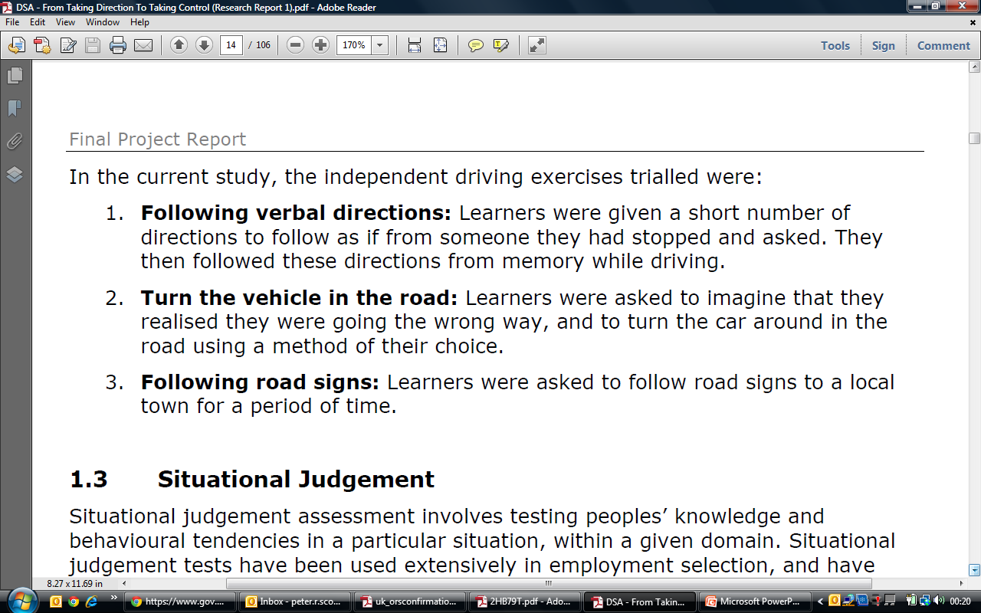

Slide 16

Situational Judgement
Intelligence
Personality
Analysis
Thought processes
Decisions
Opinions
Emotions
Preferences

Slide 17
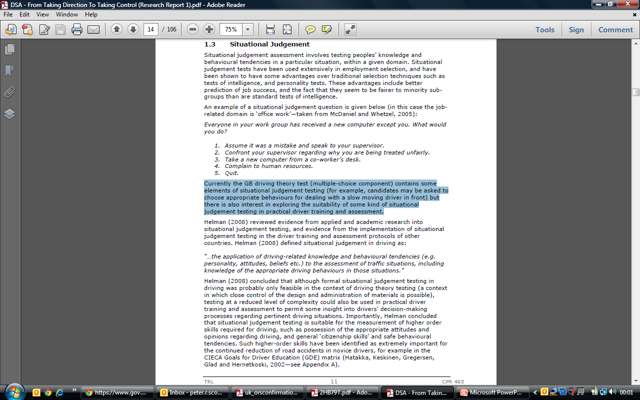

Slide 18
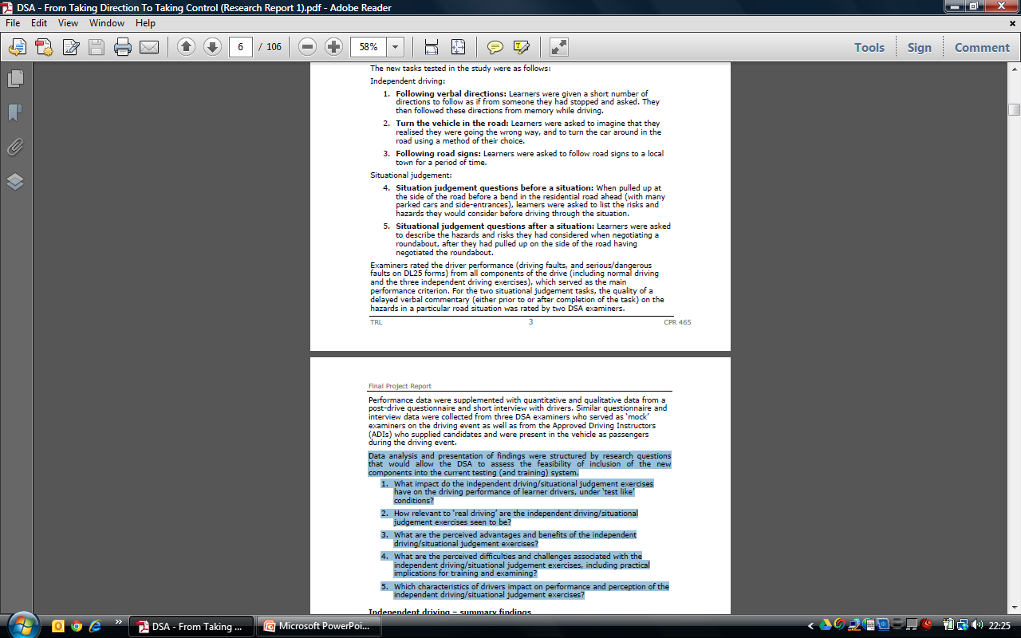


Slide 19
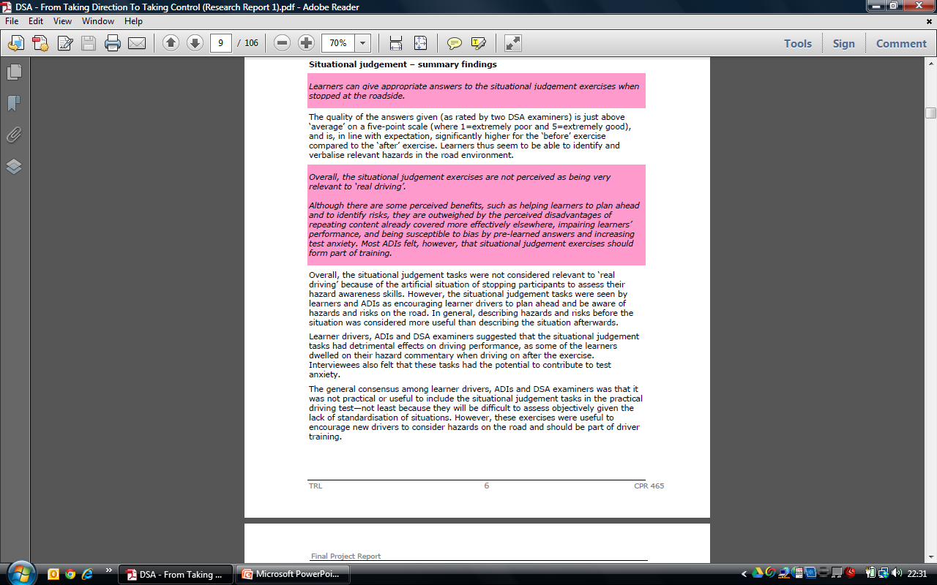

Slide 20
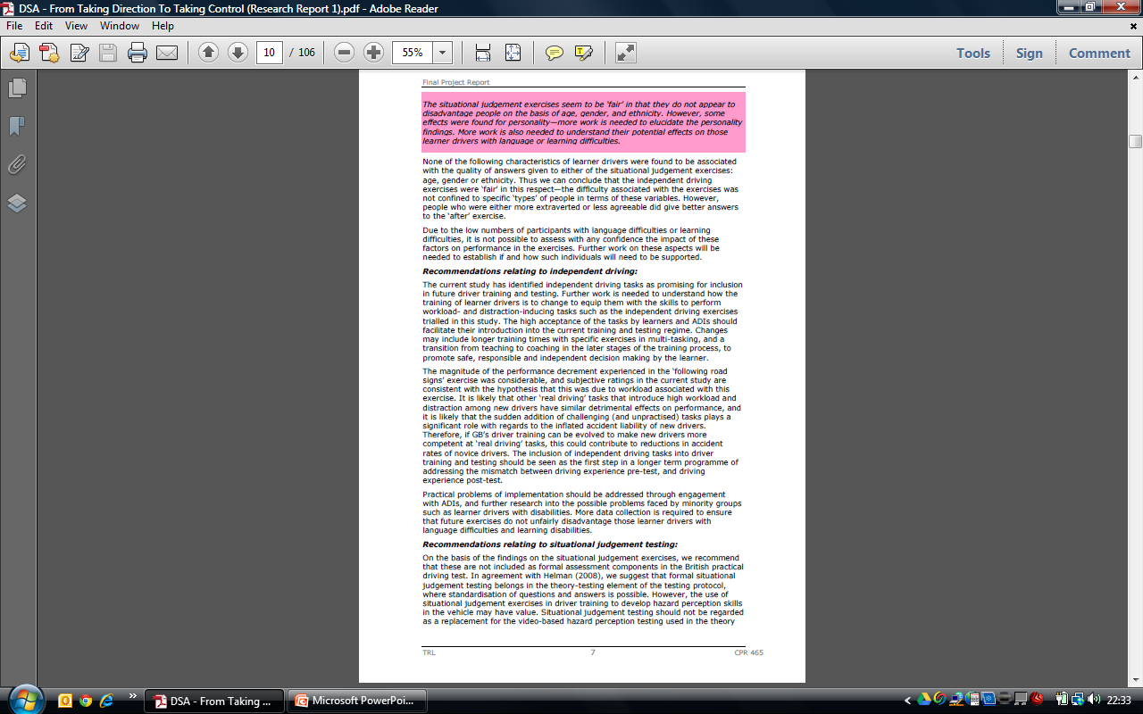

Slide 21
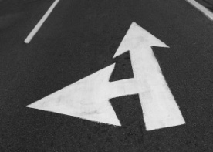
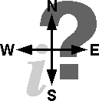
My Conclusions
Independent Driving
Situational Judgement

